Slide 1
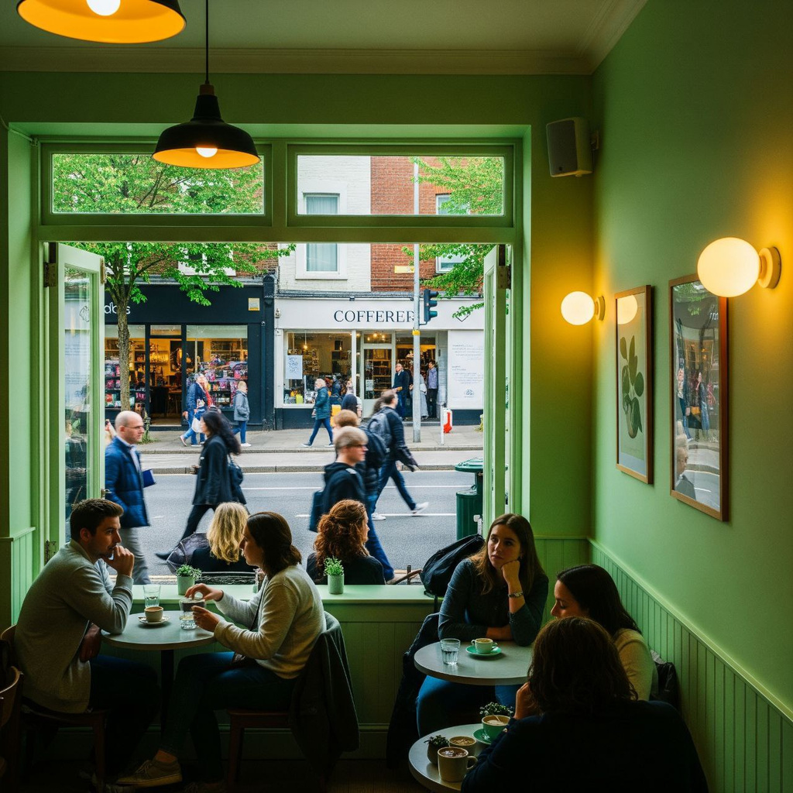

Starting a food business:
Market insights
Analyzing Deliveroo data
for strategic decisions
Tamara | Laura

Slide 2
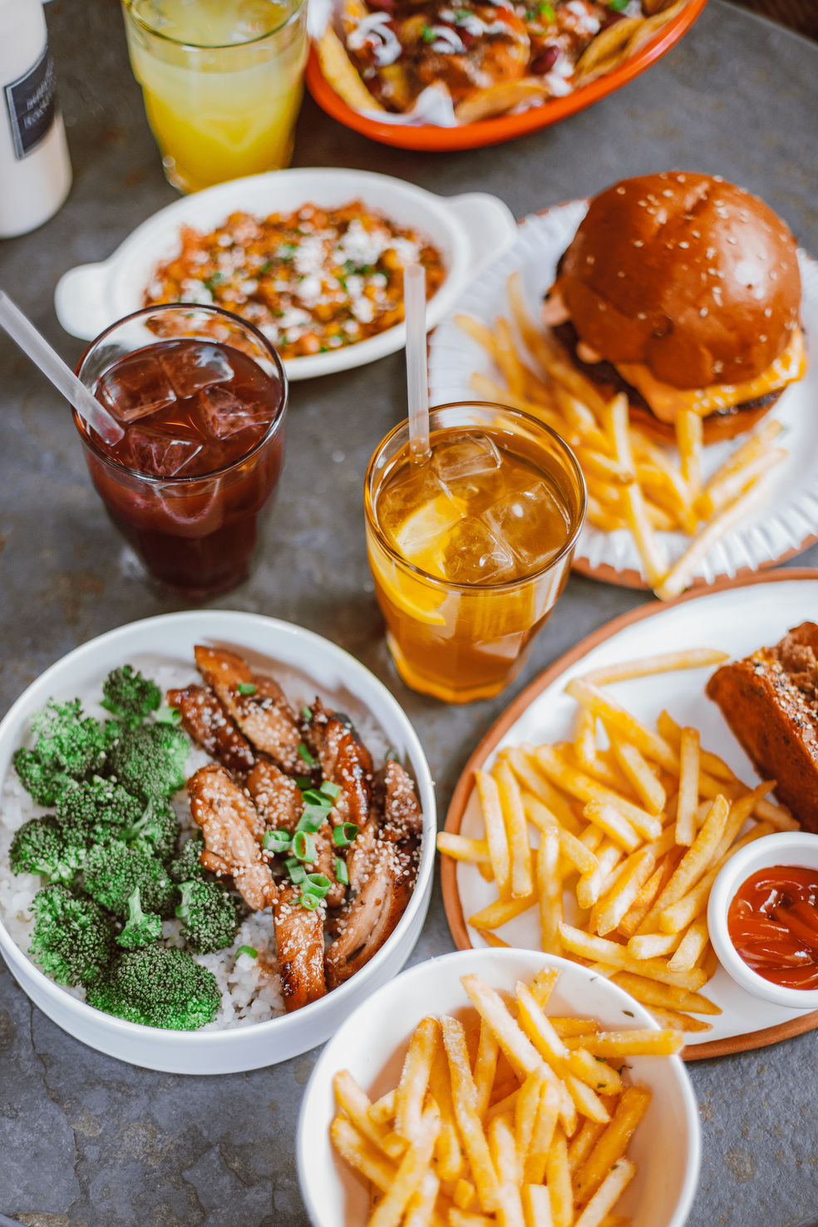



Context
Opening a new restaurant, focused on food delivery
Define:
Location
Product
Client (persona)

Slide 3

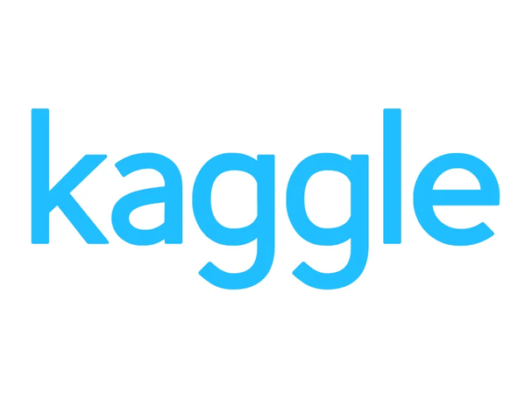

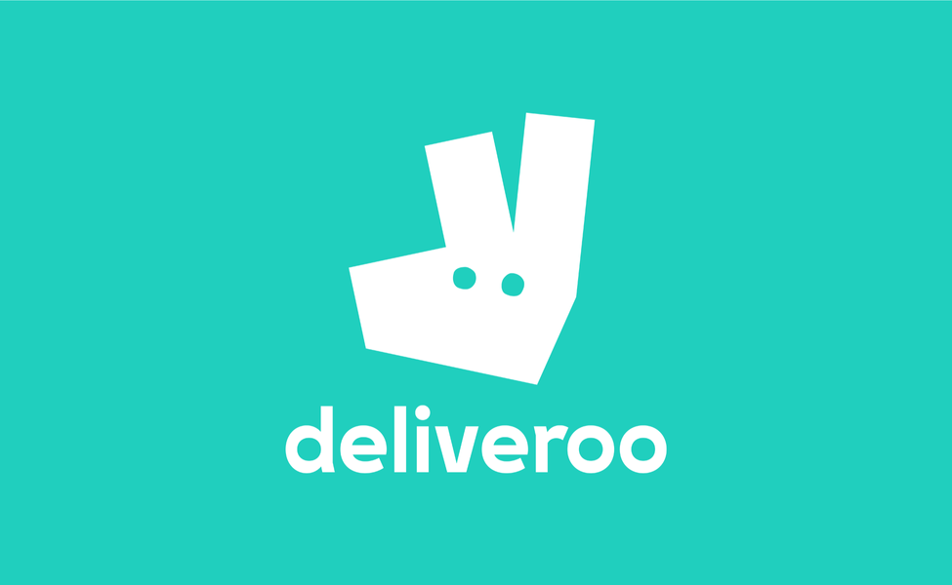
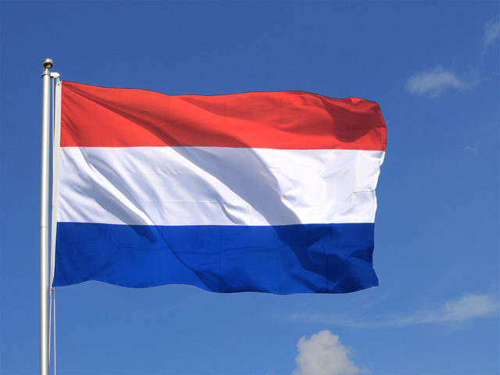
Market Research Insights

Slide 4

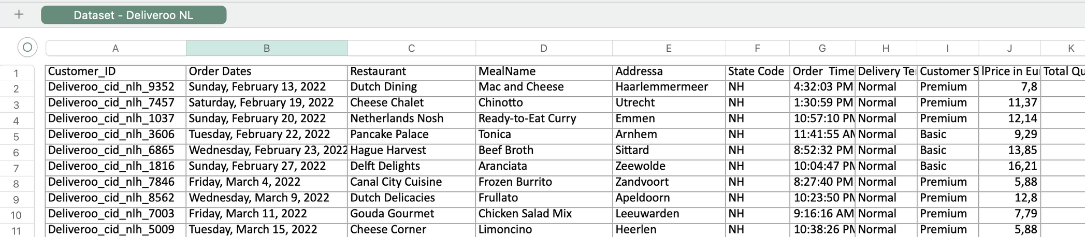
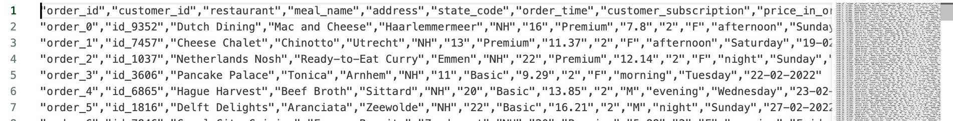
Deliveroo Data Preprocessing in Python
Cleaned missing values and duplicates
Converted date columns to datetime format
Extracted features: period of the day (e.g., morning, afternoon)
Renamed columns for consistency
Created new columns to serve as primary keys in future SQL tables
Prepared data for analysis and visualization

Slide 5
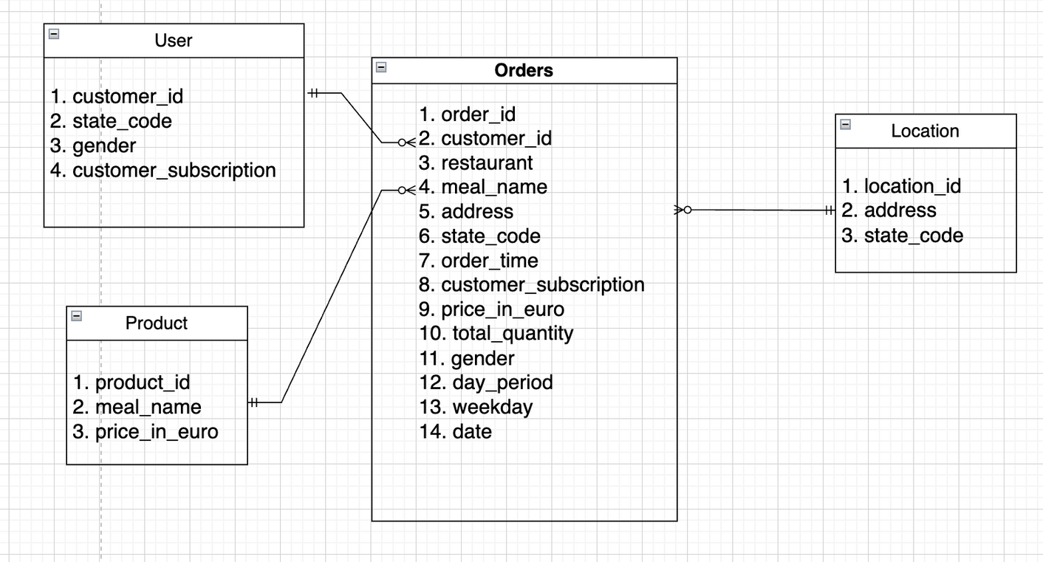
ERD Diagram
Primary keys:
Orders.order_id
User.customer_id
Product.product_id
Location.location_id
Foreign keys:
Orders.customer_id → User.customer_id
Orders.meal_name → Product.meal_name
Orders.address → Location.address

Slide 6

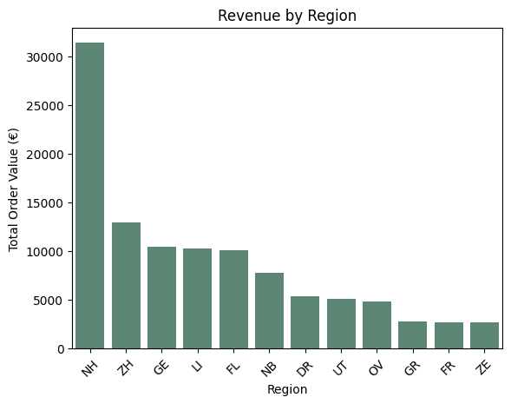
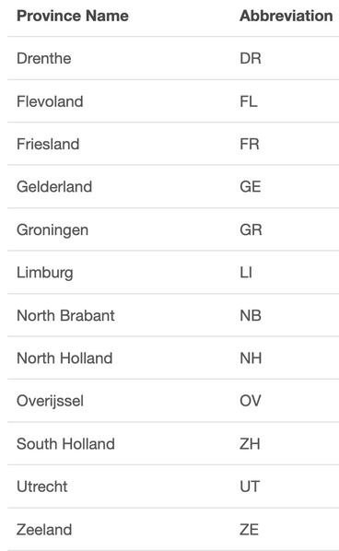


Location
Using SQL queries with GROUP BY and ORDER BY, we identified the regions with the highest customer order volume. These are priority areas for launching a new restaurant.
Python was used to visualize these insight

Slide 7
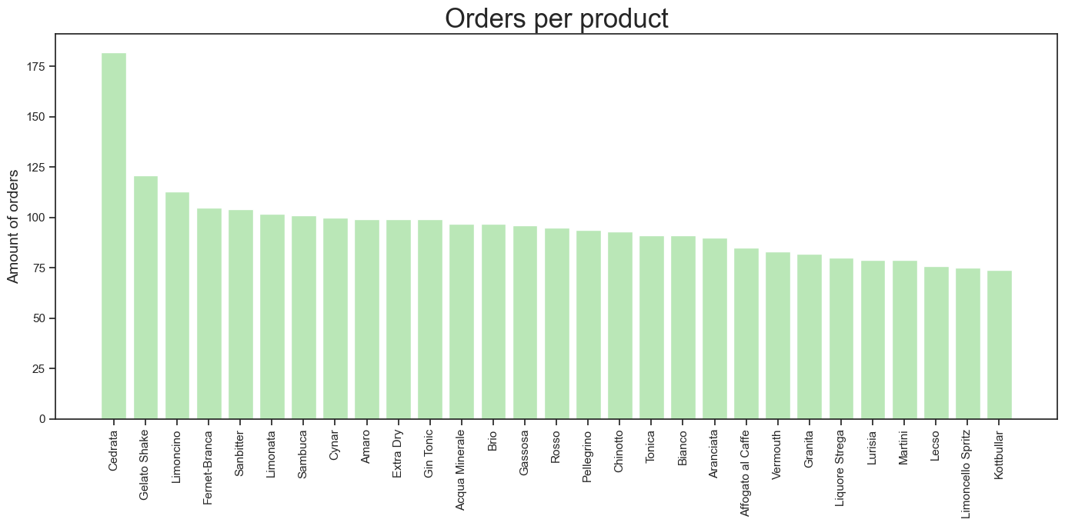
Product

Slide 8
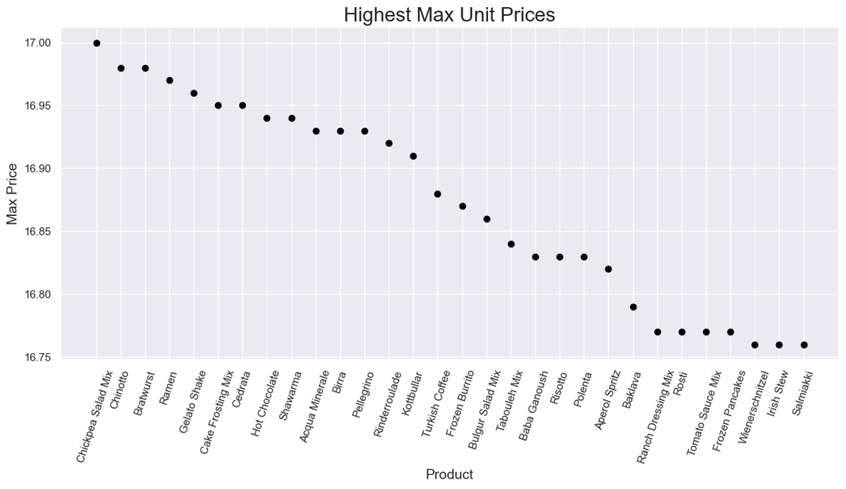
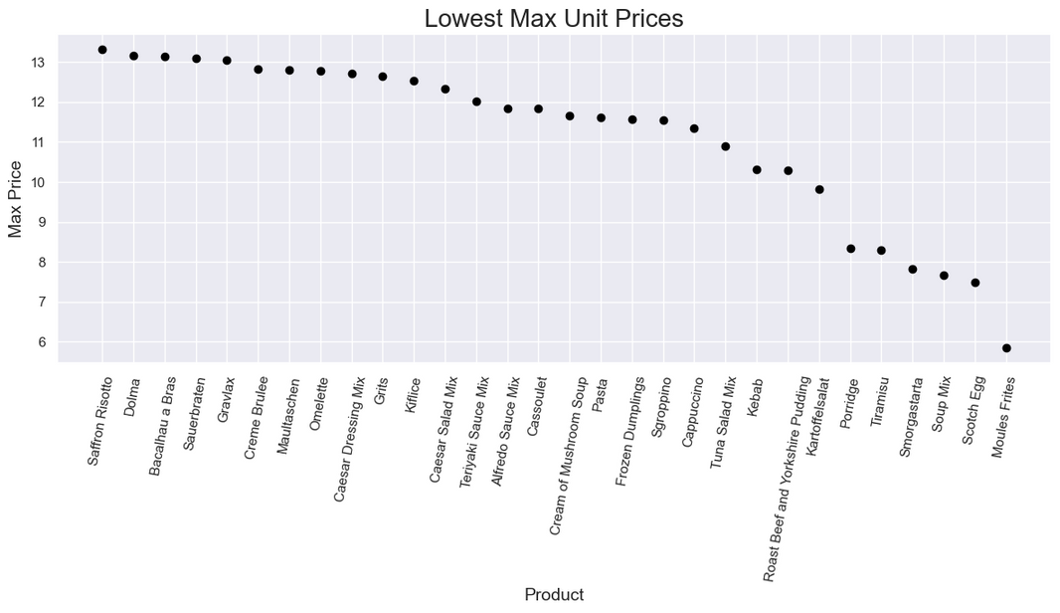

Product
Most expensive products: chickpea salad mix, bratwurst, ramen, shawarma, bulgur salad mix, tabouleh mix.
Healthy products and international cuisine have a high added value, so they can be interesting categories for this business investment.
.
Moules frites, soup mix, kartoffelsalat, roast beef, kebab and tuna salad mix are the cheapest products of the dataset.
These could be good options for our activity if we decide to focus on a lower class client as our customer persona.

Slide 9

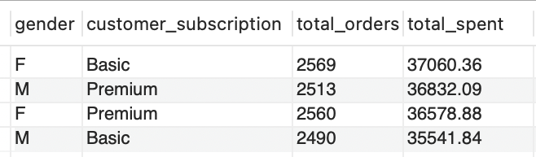
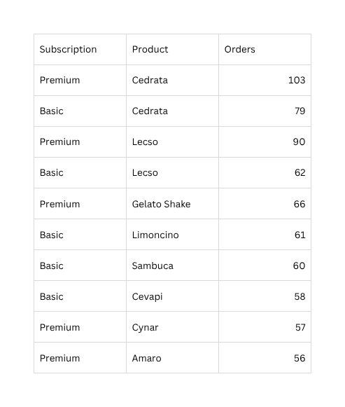
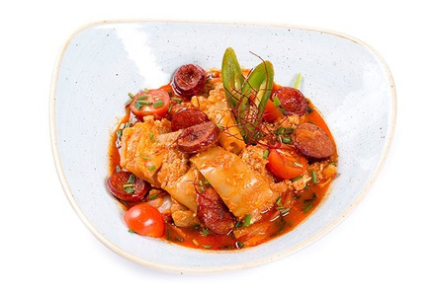
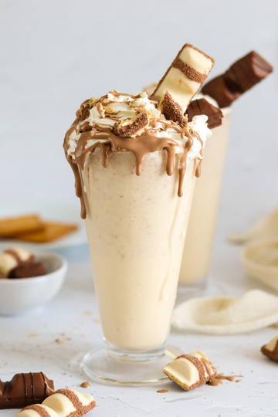
Clients
Customer gender distribution:
🧍‍♀️ Female – 50.6%🧍‍♂️ Male – 49.4%
Basic female users made the most orders and spent the most overall. But total spending is similar across all groups, so we think targeted offers could help boost loyalty.
Cedrata is the top-performing product for both Basic and Premium users. Premium customers show strong interest in Lecso and Gelato Shake

Slide 10


Challenges
Understanding of the ERD and its structure
Problems with notebook file corrupted, exporting the database
Difficulty with Github to work with file in collaboration

Slide 11
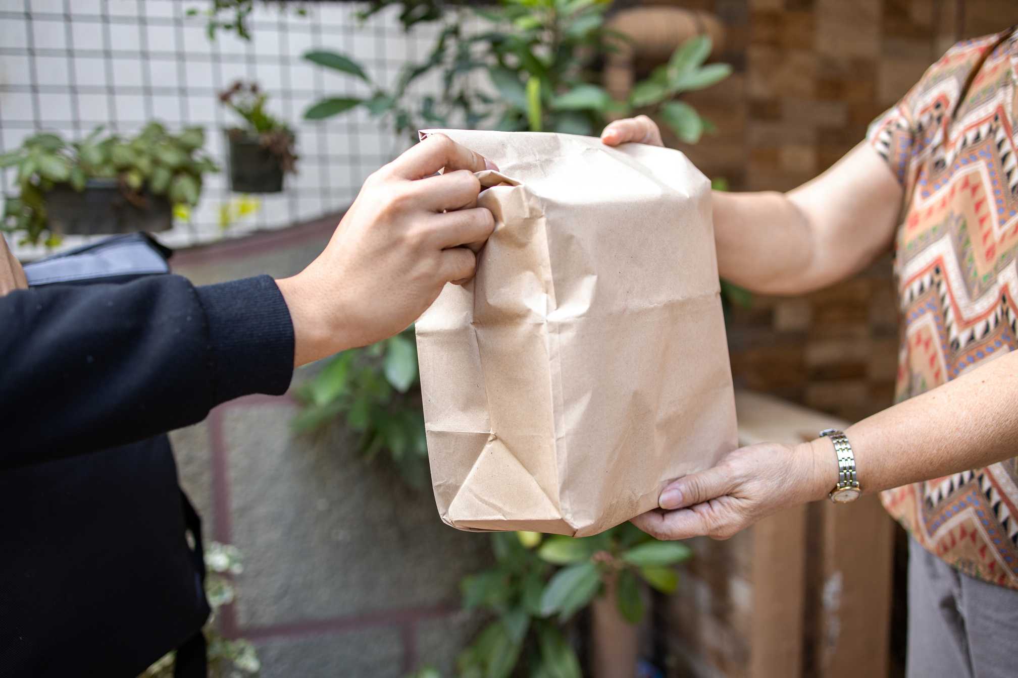
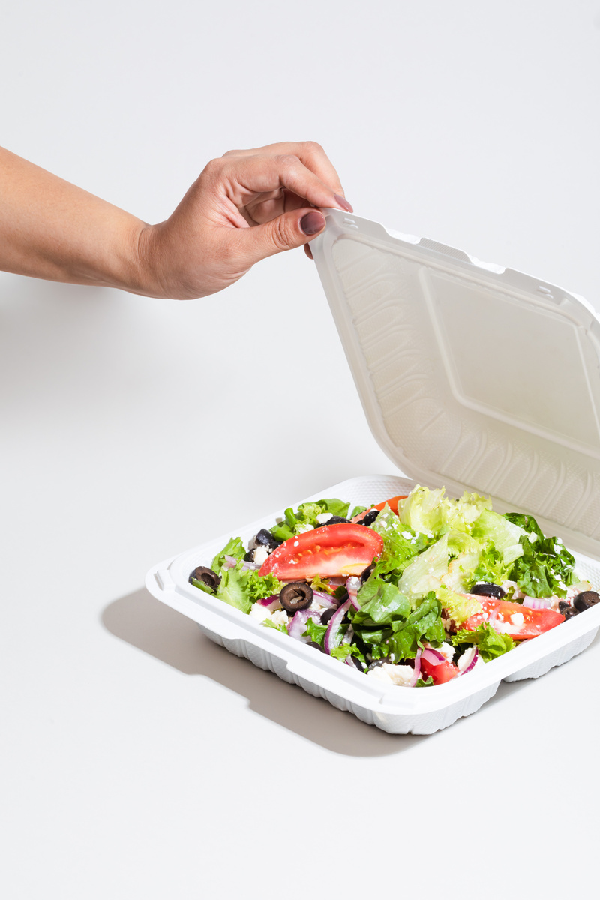
Summary
Location - Our analysis showed that the highest number of orders came from Noord-Holland (NH). This makes it the most strategic location for launching our restaurant.
Product - The most ordered products are beverages, both alcoholic and soft drinks. So an interesting approach to define our product would be to decide between a high added value product, like healthy foods and international cuisine, or a lower price product like moules frites or kebab.
Client (persona) - Our core customers are female users, who place the most orders and generate the highest revenue. They enjoy Italian drinks and desserts as well as Balkan-style food. However, spending is balanced across all groups - meaning the restaurant could appeal to a wide range of customers with the right promotions.

Slide 12
Thank you for your attention!

